Slide 1
Formal Verification in Reinforcement Learning

Slide 2
//Topics
Introduction
Overview Verification and Reinforcement Learning
//→ NASA Paper
Research Question: How do we handle unknown situations?
//We should be then more specific. e.g. safe online learning, online verification, ...
State of the Art / Related Research + Bottlenecks/Problems
E.g. penality based approaches don‘t make accidents disappear but just very rare + not possible for safe online learning (since you need to learn first not to do an accident)
Proposed Method
Experiments?
Next steps / Problems / Conclusion

Slide 3
//Introduction
Why is this topic relevant
What are the challenges
Motivation from other fields where formal verification succeeded
Use cases: (Not only) Autonomous Driving

Slide 4
//Research Question
How can we ensure that the model will always act in a safe way? (not damaging something)
How can we deal with uncertain situations?
Does Formal Verification make autonomous driving 100% safe?
Other Questions we could name (but not address)
“Small perturbation of input will not affect the learning“

Slide 5
//Introduction to Formal Verification
Rough overview over methods
PRISM, System monitors, ...
Maybe name some approaches for autonomous driving
I would treat formal verification as a “black box“ in our setting.

Slide 6
//Formal Verification and RL
Nasa paper
What can be verified? What different kind of learning (offline, online) and verification methods are there?
Specify what we want to verifiy / do?
“Model will always be in a non-dangerous state according to “

Slide 7
//State of the Art
Survey (everything pre 2013)
Paper we collected...

Slide 8
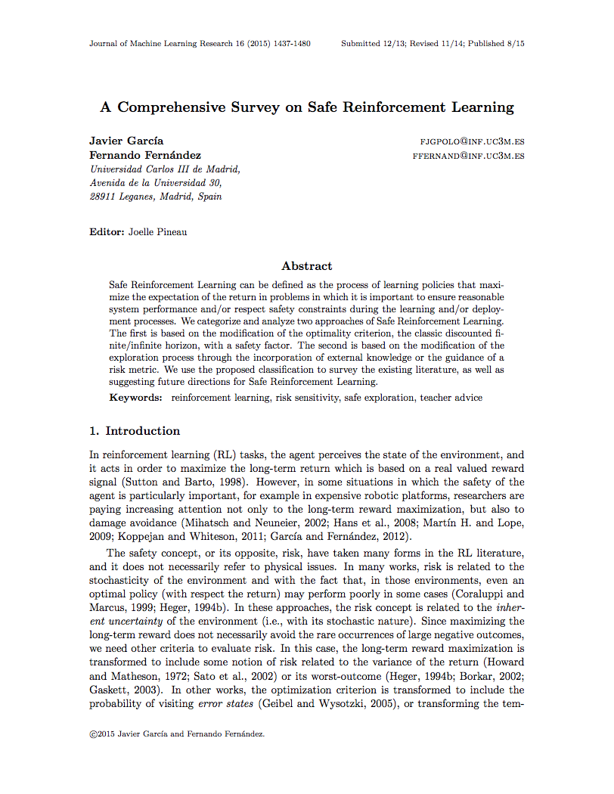
A Comprehensive Survey on Safe Reinforcement Learning (≤ 2015)
…

Slide 9
Optimization Criterion
Classical criterions: maximize expected return
Can we modify this to make the learning “safer”?

Slide 10
Worst Case Criterion
Maximize worst-case return to reduce variability by the policy
In practices too harsh

Slide 11

Risk-Sensitive Criterion
Balance between return and risk: $β$
Penalize Variance via $β<0$
Problem: Small variance does not imply small risk

Slide 12
Constrained Criterion
Maximize return subject to given constraints

Slide 13
Constrained Criterion
General strategy: Find equivalent non-constrained problem for given constrained one
Constrains usually only use expectation and variance

Slide 14
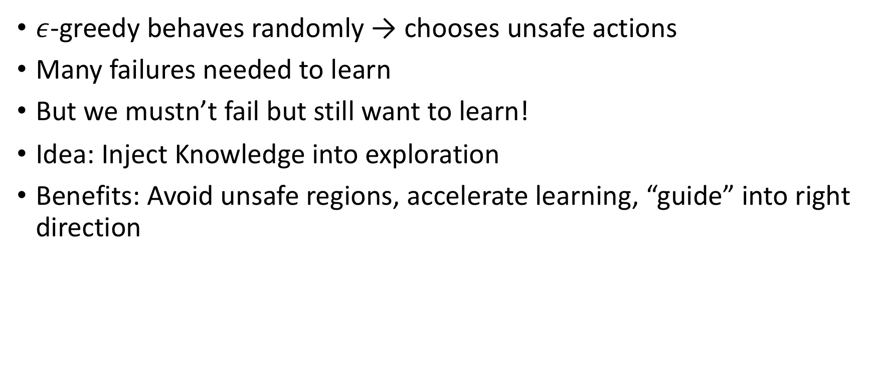
Modification of the Exploration Process
$ε$-greedy behaves randomly → chooses unsafe actions
Many failures needed to learn
But we mustn’t fail but still want to learn!
Idea: Inject Knowledge into exploration
Benefits: Avoid unsafe regions, accelerate learning, “guide” into right direction

Slide 15
Initial Knowledge
Accelerate training

Slide 16
Demonstrations
Use demonstrations to derive a policy

Slide 17
Teacher
Teacher can help agent
Interaction between teacher and agent
If learner is ”unsure”
If teacher thinks it needs to

Slide 18
Teacher Advice

Slide 19
Risk-directed exploration
Use risk-measure for action selection

Slide 20
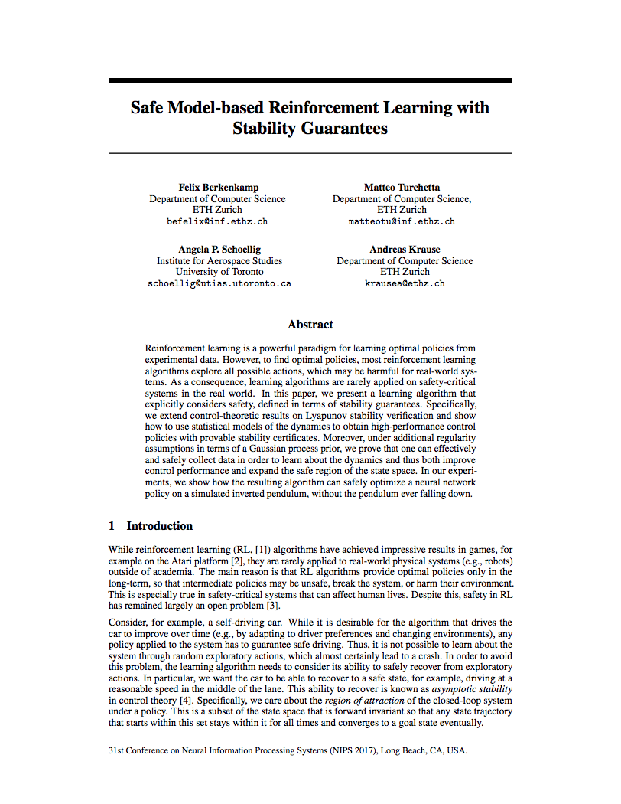
Safe Model-based Reinforcement Learning with Stability Guarantees (2017)
Main Idea: Be able to recover from every situation: “Asymptotic Stability”
Start with an initial, safe policy
Compute “region of attraction” via Lyapunov functions
Exploration will increase safe region and region of attraction

Slide 21
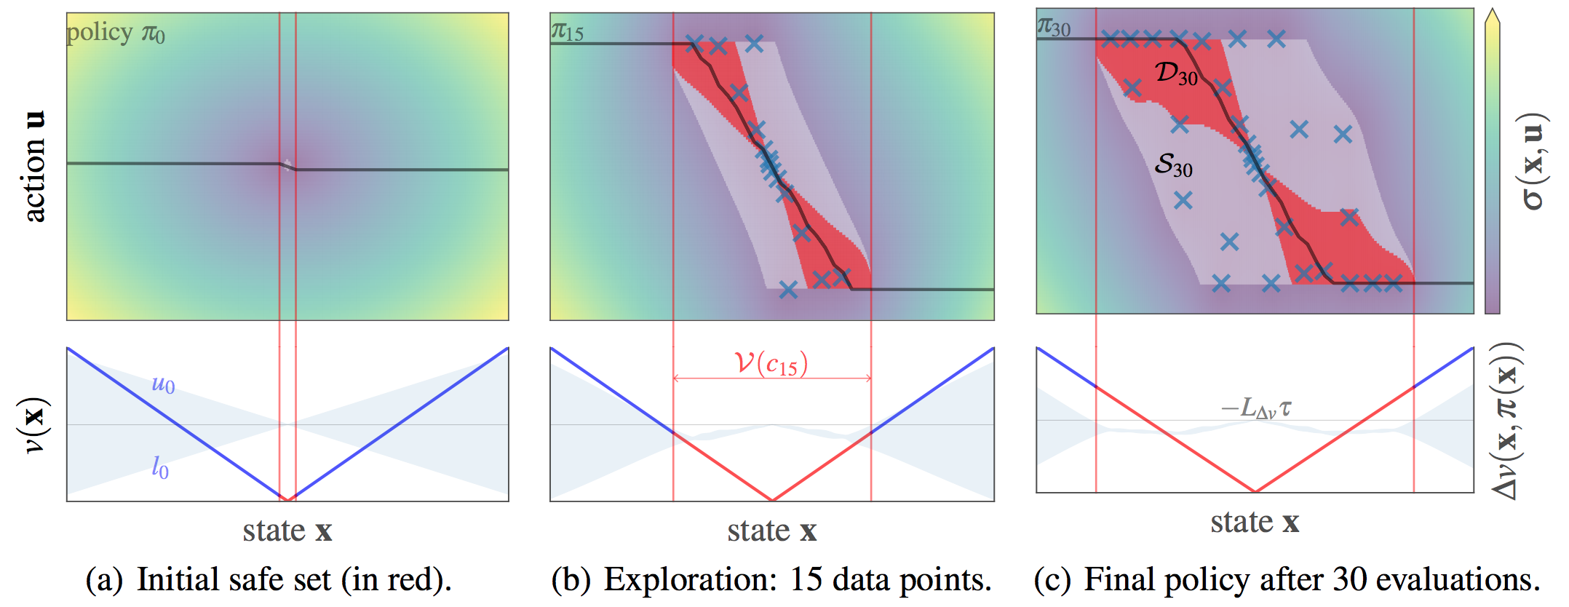
Region of Attraction

Slide 22
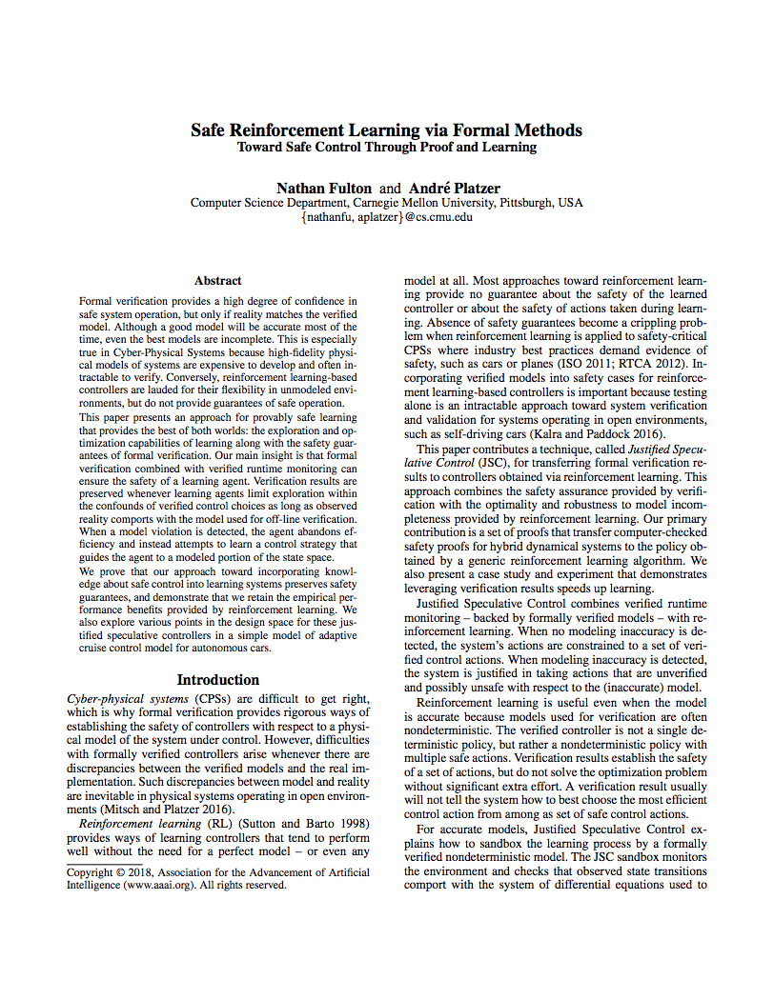
Safe Reinforcement Learning via Formal Methods (2018)
Model accurate: Choose safe action that maximizes reward
Model inaccurate: Choose any action that maximizes reward
Model Monitor: Is the model accurate?
Controller Monitor: Is an action safe?
Any safe action keeps the system safe

Slide 23
Algorithm
JSCGeneric(init, (S,A,R,E), choose, update, done, CM, MM) {
prev := curr := init;
a0 := NOP;
while (!done(curr)) {
if (MM(prev, a0, curr))
u := choose({a ∈ A | CM(a,curr)});
else
u := choose(A);
prev := curr;
curr := E(u, prev);
update(prev, u, curr);
}
}

Slide 24
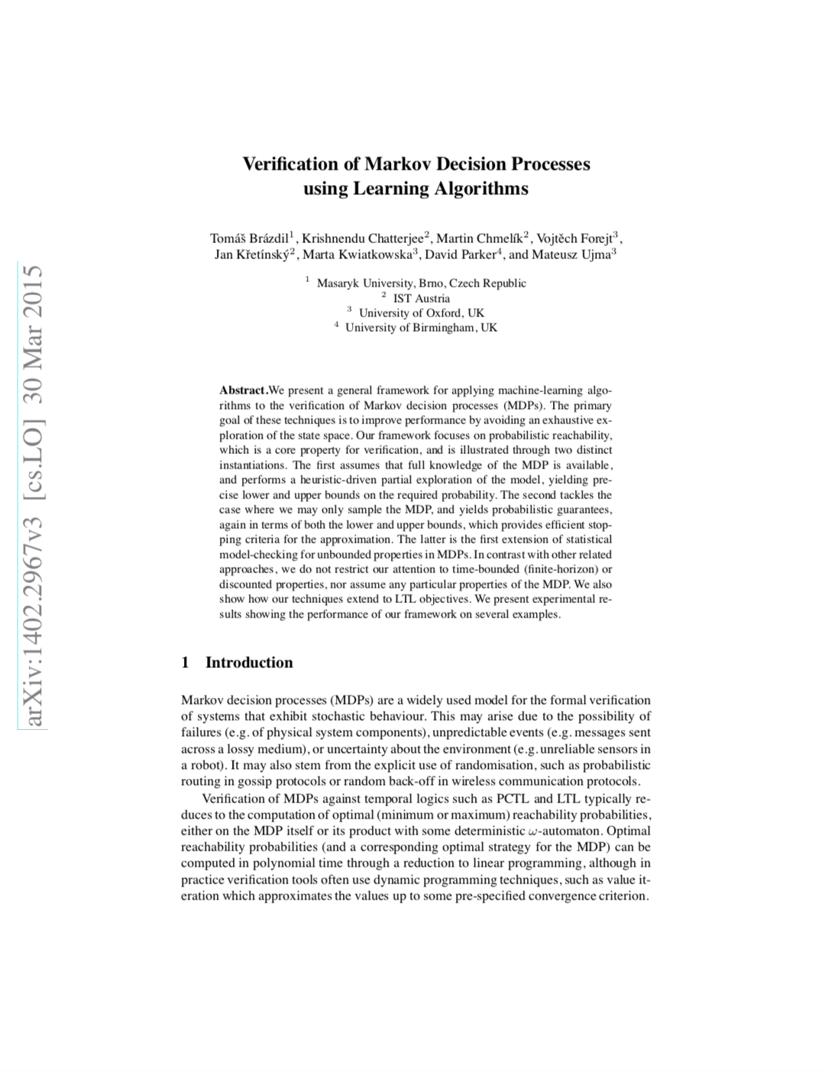
Verification of Markov Decision Processes using Learning Algorithms (2015)
?

Slide 25
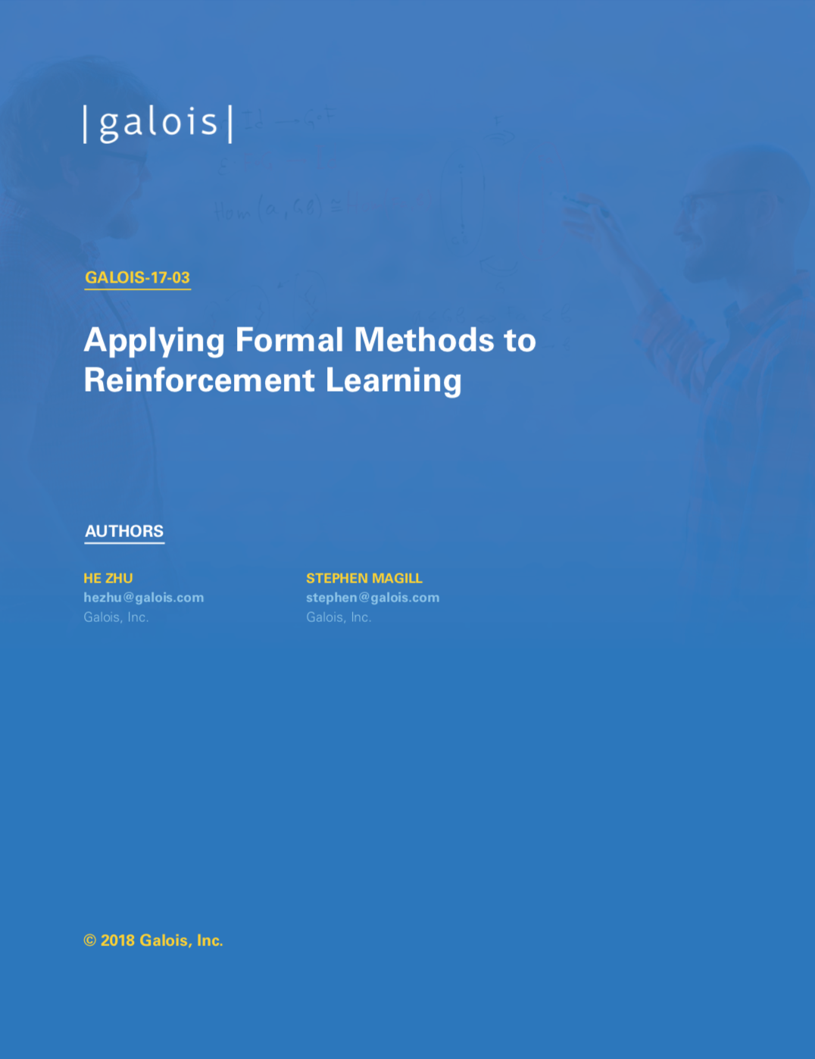
Applying Formal Methods to Reinforcement Learning (2018)
Learn from demonstrations
Problem 1: Agent may encounter unseen situations
Solution: Dataset-Aggregation
Problem 2: Generate “expert” trajectories automatically
Solution: Reward function synthesis using formal methods.

Slide 26
//Proposed Method
Name some ideas?
Advantages and disadvantages
Boost safe method with formal verification
Show that a certain approach does not work
...

Slide 27
//Experiments
tbd

Slide 28
//Formal Verification – The solution?
Conclusion, Research Direction, ...
Short discussion on the research questions
Why formal verification does not make driving 100% save

